Slide 1


UD03. Hard disk. Scheduling
Computer Systems
Desarrollo de Aplicaciones Web
1er Curso
Curso 2019-2020

Slide 2
What is scheduling
FIFO
SSF
SCAN
CSCAN
LOOK
CLOOK

Slide 3
What is scheduling?
It is the method to decide which request (either read or write) has to be processed in first place
Perhaps you are thinking that the hard drive processes the requests in order of arrival, but this solution is not very efficient
Objective: To minimize the search time, which is directly proportional to the distance search

Slide 4
Scheduling
Several possiblities: FIFO, SSF, SCAN, CSCAN, CLOOK….
We are going to show several examples using the following request queue:
98, 183, 37, 122, 14, 124, 65, 67
It is assumed that, at the beginning, the heads are in the track 53

Slide 5
FIFO (FCFS)
First In First Out or First Come First Serve
The request are processed in order to arrival.
It is the easier to understand and to implement but, probably, the least efficient.

Slide 6
FIFO (FCFS)

Slide 7
Shortest Seek Task First (SSTF)
Requests that minimize head movement from the current position are processed first
It can cause starvation of some requests
Starvation occurs when a request is never cared because they always appear closer vain requests

Slide 8
Shortest Seek Task First (SSTF)

Slide 9
SCAN
Arm movement always starts at one end of the disc and continues to the other. There, the direction is changed and becomes the other end.
It avoid backward and forward movements.
In terms of time, changing the direction of the movement is a expensive operation because of the inertia.

Slide 10
SCAN

Slide 11
C-SCAN
Similar to SCAN but only in one direction
No requests are served while the heads return to the initial position
Going from last to first is done in a single movement and it is very fast

Slide 12
C-SCAN

Slide 13
LOOK
Similar to SCAN but it does not need to arrive to the end of the disc.
It changes its direction in the smaller and in the bigger request

Slide 14
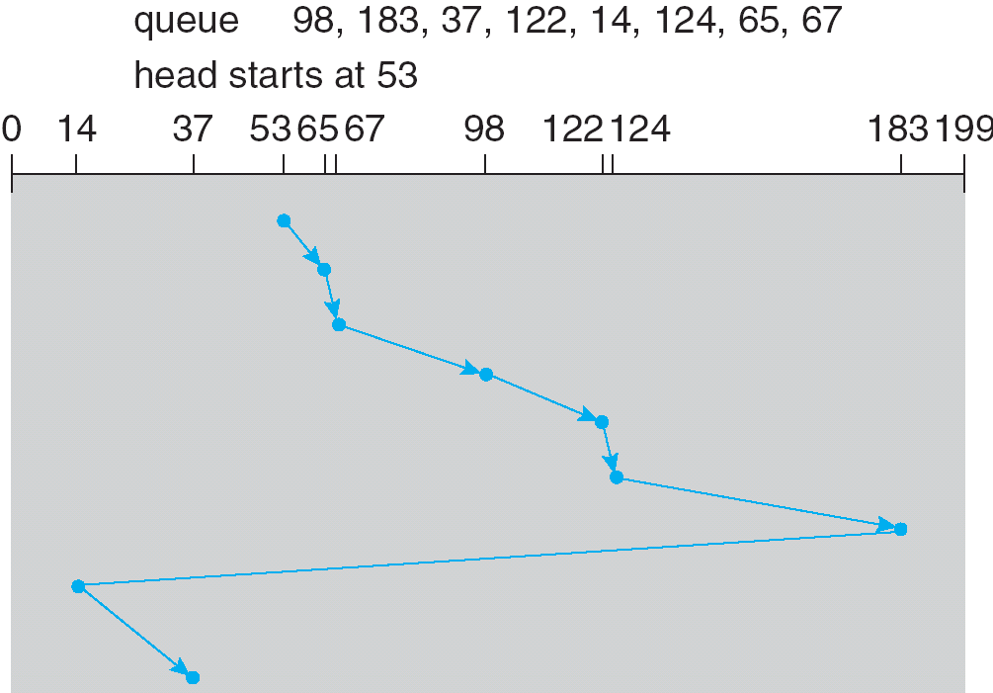
LOOK

Slide 15
LOOK
Similar to C-SCAN but using the idea of LOOK

